Slide 1



















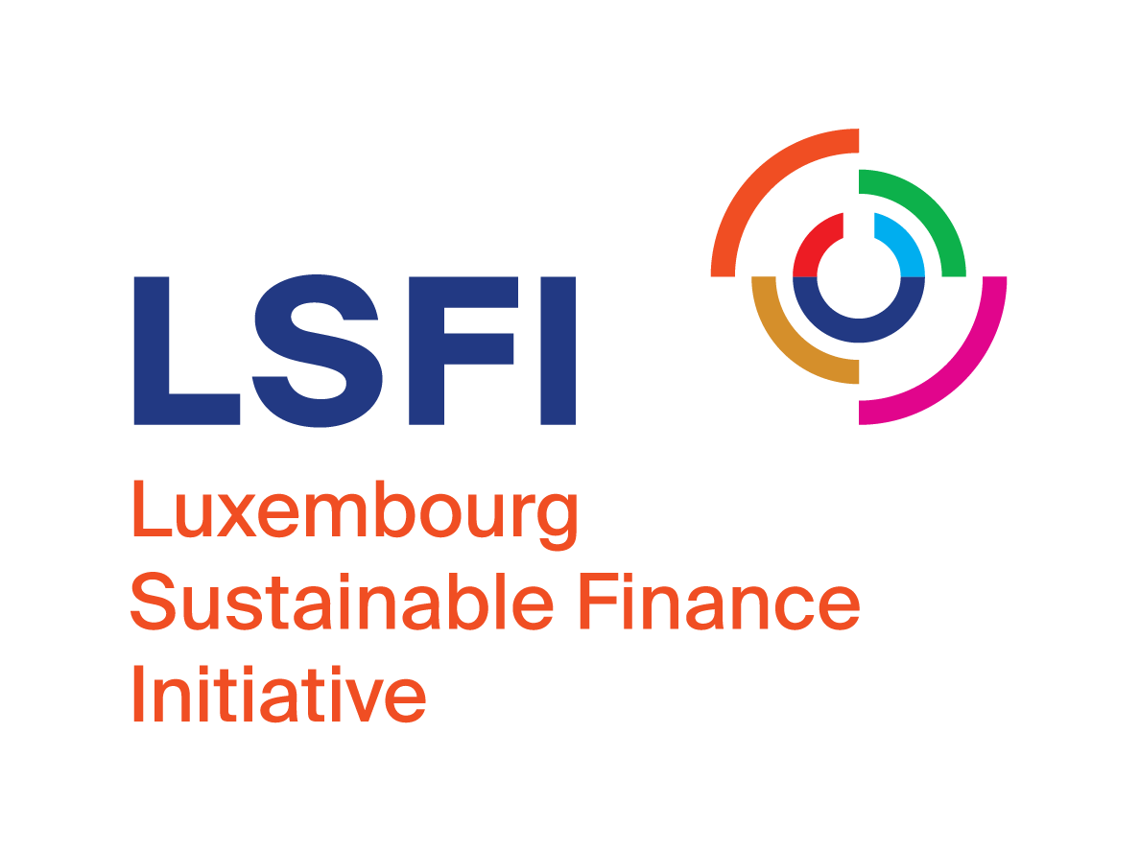
Survey on sustainable finance among the general public:
Interest in the topic but more information needed
To what extent do you think financial sector investments have an impact on the following areas?
1. Perception of the impact of sustainable finance
74%
Believe that the financial sector plays an important role in the transition of our economies towards more sustainability
58%
Energy development
71%
Believe that each of us can contribute to a more sustainable world through our financial decisions.
52%
Society and communities
49%
Environment
and climate
39%
Humain
rights
35%
Biodiversity
The survey shows that the majority of respondents believe that the financial sector plays an important role in the transition of our economies towards more sustainability and can have a positive impact in the development of sustainable energy, society or the environment.
2. Understanding and need for information
47%
Should the general public be more informed to better understand what sustainable finance is?
1% :
Strongly disagree
7% :
I don’t know
Do not know or have difficulty understanding what «sustainable finance» is.
4% :
Tend to disagree
The public (43%) links sustainable finance to "impact on the environment". The other dimensions (social and governance) are not well-known.
*10% other (e.g. social responsibility, equitable trade)
40% :
Tend to
agree
47% :
Strongly agree
In general, sustainable finance is a subject that is difficult for the general public to understand; for those interviewed, transparency and the need to be better informed are key to overcoming the lack of knowledge and understanding of sustainable finance.
3. Investment and information level in sustainable finance products
27% of people have already proactively inquired about investing in sustainable products.
Have you already or will you in the future invest in
sustainable financial products?
21%
53%
26%
24% of people report having been approached about investing in sustainable products.
Yes, I have already invested in sustainable financial products
No, I haven't done it yet, but I can imagine investing in sustainable financial products
No*
* Especially the elderly said "no".
The general public has a strong interest in financial products related to sustainable finance and the potential for investment in these products is significant.
4. Investment triggers
Profit
Risk level
Respect for
human rights
Reputation of companies involved
1°
2°
3°
3°
Respondents claim that the top 3 factors that trigger an investment are firstly profitability, secondly the level of risk and thirdly (equally) the reputation of the companies concerned and the respect of human rights.
5. The role of the banker
What are the most reliable sources of information?
61%
Banks
44%
The economic and financial press
The survey shows the trust and expertise given to the banker.
37%
Independent financial advisors
31%
Family and friends
29%
Internet
(social networks excluded)
This survey was realized, with the methodology of the supplier ILRES, by:
CSSF - www.cssf.lu
Fondation ABBL - www.abbl.lu/en/consumers/financial-education/abbl-foundation
LSFI www.lsfi.lu

